Slide 1
Our aim is a system where all young people are prepared by their education to succeed in life
  A world class system, where
    All young people continue in education or training until at least the age of 18
    Achievement levels match participation levels
    The link between deprivation and low achievement is broken

Slide 2
Some of our targets
    Increase the proportion of 19 year olds with L2 and L3 qualifications
    Reduce the proportion of 16-18 year-olds who are NEET
    Increase participation in learning among 17 and 18 year olds
    Better prepare young people for progression into further and higher education and employment
    The new curriculum and qualifications are key
    to future success

Slide 3
There are 3 main aspects to the reform programme
Encouraging young people to stay in learning now, on the right courses, and supporting them to achieve – Raising Attainment now
Reforming curriculum and qualifications so that more young people are motivated and engaged and so what they learn is a better preparation for life – Curriculum and Qualifications Reform
Creating the infrastructure (workforce, providers, facilities, local partnerships and arrangements) capable of delivering the curriculum and qualifications entitlement – 14-19 Local Delivery

Slide 4
The 14-19 Curriculum Reforms consist of:
strengthened GCSEs and A levels
expansion of Apprenticeships
the new Diploma route
a Foundation Learning Tier of qualifications
functional skills in English, maths and ICT embedded in all learning routes
a modified secondary curriculum 3
a learning entitlement for all 14-19 year olds from 2013
simplification of the qualifications routes
Alongside:
a continuous drive to raise standards
plans to raise the participation age to 18 by 2015

Slide 5
Key messages underpinning the Reform Programme
The importance of skills acquisition, including employability skills
Simplification of the qualifications routes
Confidence (and understanding) of employers and universities

Slide 6
The biggest change in a generation
This is the biggest change in educational opportunity for a generation
It is all about giving our young people preparation for a better quality of life and better chances for their lives in the future
It is making education more connected to the real world and future skills and employment opportunities
It is a very positive move and we are excited about it: offering a new range of options and different learning styles in young people so they can pick the path that will work best for them

Slide 7
Why all this change is necessary?
The curriculum today meets the needs of some – but not all of our young people
The new curriculum we are bringing in is new in both what young people will be learning and how they learn – with the aim of creating a learning route that is right for everyone
The world is changing – and we need to change with it
Even though we have made real progress in the past 10 years, other countries are going even faster

Slide 8
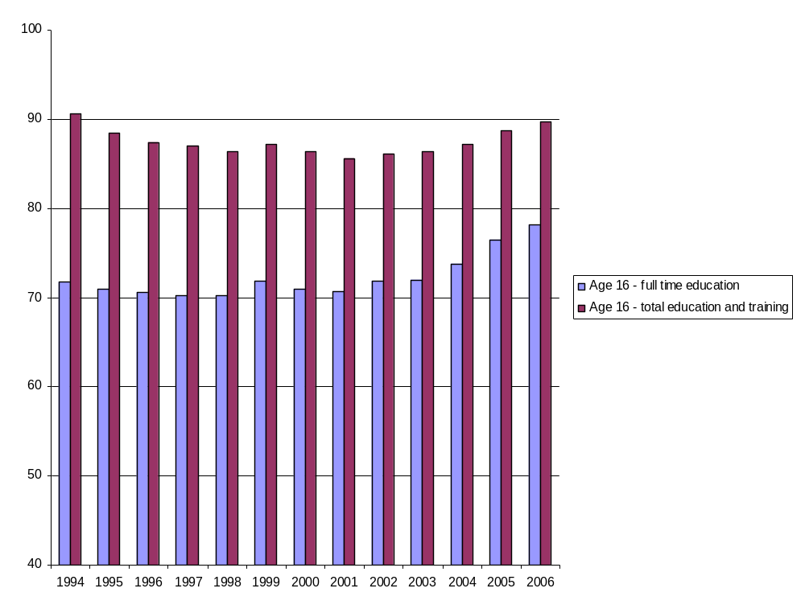
Participation is on the way up

Slide 9
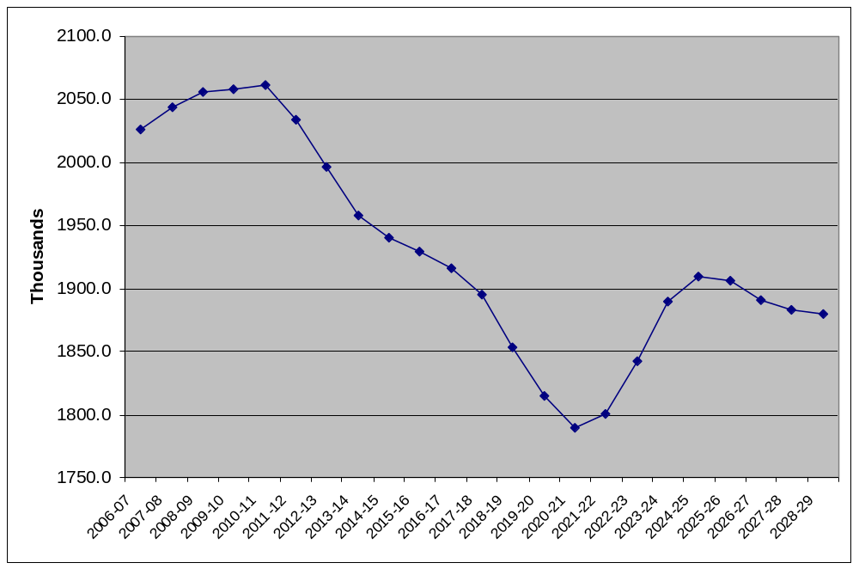
At a time of increasing demand for graduates, but lower and lower numbers of young people
Number of 18-20 year olds 2006/7 – 2028/9
Source: HEPI, Demand for Higher Education to 2020 and beyond (2007); ONS and Government Actuary's Department (2005 based projections, published in August 2006), adjusted by DfES for academic years.

Slide 10


14-19 Qualifications Strategy:
4 routes available to all by 2013
14-19 key national suites and frameworks
GCSEs,
A Levels
Functional Skills
Foundation Learning Tier
Progression Pathways

Slide 11











Curriculum progression routes
Level 4
Level 3
Level 2
Level 1
Foundation Degree
Diploma in [occupation]
Level 4
Degree
Degree
GCE
A levels
Diploma
Level 3
Advanced Apprenticeship
NVQ
Level 3
Certificate in
[occupation]
Award in
[occupation]
GCSE
A* -C
Diploma
Level 2
Apprenti-
ceship
NVQ
Level 2
Certificate in
[occupation]
Young
Apprenti-
Award in
[occupation]
GCSE D -G
+other provision
Diploma
Level 1
NVQ
Level 1
Certificate in
[occupation]
1
Award in
[occupation]
Traditional route
Diploma
Apprenticeship route
Occupational route
(NVQ, BTEC, OCR national etc)
National Qualifications Framework
1
14-19 Qualifications
Mostly 16 +
Adult and16+ Qualifications

Slide 12
National rollout of Diplomas
Phase | Employment sector/subject area | Availability
Phase 1 | Construction and the Built Environment (CBE) Creative and Media (CM) Engineering (Eng) Information and Technology (IT) Society Health and Development (SHD) | Sept 2008
Phase 2 | Business, administration and finance (BAF) Environmental and Land Based Studies (ELBS) Hair and Beauty Studies (HB) Hospitality and Catering (HC) Manufacturing and Product Design (MPD) | Sept 2009
Phase 3 | Public Sector Retail Sport and Leisure Travel and Tourism | Sept 2010
Phase 4 | Science Languages Humanities | Sept 2011

Slide 13
The Diploma –
how is it different?
Blends theoretical and applied learning to learners aged 14-19
Builds in progression routes
  Mastery of the basics for all
  Increased challenge at all levels
Emphasis on skills development: not job specific training – employability and learning skills
A composite qualification developed with employers and universities
Offered by schools in partnership with colleges and other schools

Slide 14
Diploma components
Principal Learning
Generic Learning
Additional/
specialist learning
Skills, knowledge and understanding central to the chosen Diploma
At least 50% is applied
Employer designed and endorsed
Functional skills: English, Maths, ICT
Personal, learning and thinking skills
Optional units
Can broaden and deepen learning programme
Progression pathways
Work experience (minimum 10 days), Project

Slide 15
Diploma equivalence
Diploma Level | Equivalence | UCAS (max)
Foundation Diploma | 5 GCSEs at L1 (grades D-G)
Extended Foundation Diploma | 7 GCSEs at L2 (grades A*-C)
Higher Diploma | 7 GCSEs at L2 (grades A*-C)
Extended Higher Diploma | 9 GCSEs at L2 (grades A*-C)
Progression Diploma | 2.5 A levels (grades A*-E) | 300
Advanced Diploma | 3.5 A levels, (grades A*-E) | 420
Extended Advanced Diploma | 4.5 A levels, (grades A*-E)

Slide 16
High level timeline
September 2008
First secondary students to be affected by RPA;
First 5 Diplomas taught;
September Guarantee extended to 17 year olds;
First teaching of new A levels;
Extended Project begins;
2009
First 10 Diplomas being taught;
New GCSEs start;
2010
Foundation Learning Tier available;
14 Diplomas available;
New English, ICT and Maths GCSEs taught with Functional Skills;

Slide 17
High level timeline continued
High level timeline
2015
RPA for all until 18
2011
16-19 funding transferred from LSC to LA’s;
Science, Languages and Humanities Diplomas taught;
2013
Entitlements to all Diplomas and Apprenticeships;
RPA for all 17 year olds;
Qualifications review;

